Slide 1
STA9690 Final Project
Advanced Data Mining
Christopher Lang
December 12, 2017

Slide 2
The Spambase Dataset
A dataset of emails and several key features that describe the content written in the email body
Number of Emails (n) | 2695
Number of Predictors (p) | 57 – 3 = 54 (3 predictors are all zero)
Response | 1512 (~56%) spam 1183 (~44%) non-spam
Sourced Spambase from:
UCI Machine Learning Repository
https://archive.ics.uci.edu/ml/datasets/spambase
Predictor Description
Predictors are broken into three types of measures
Word Frequency % of total words in an email | word_freq_make
 | word_freq_internet
 | word_freq_hp
 | … …
Character Frequency % of total characters in an email | char_freq_semicolon
 | char_freq_exclamation
 | char_freq_dollarsign
 | … …
Capital Run Length The length of a sequence of capital letters | capital_run_length_longest
 | capital_run_length_average
 | capital_run_length_total
 | … …
45 predictors (83%)
6 predictors (11%)
3 predictors (6%)

Slide 3
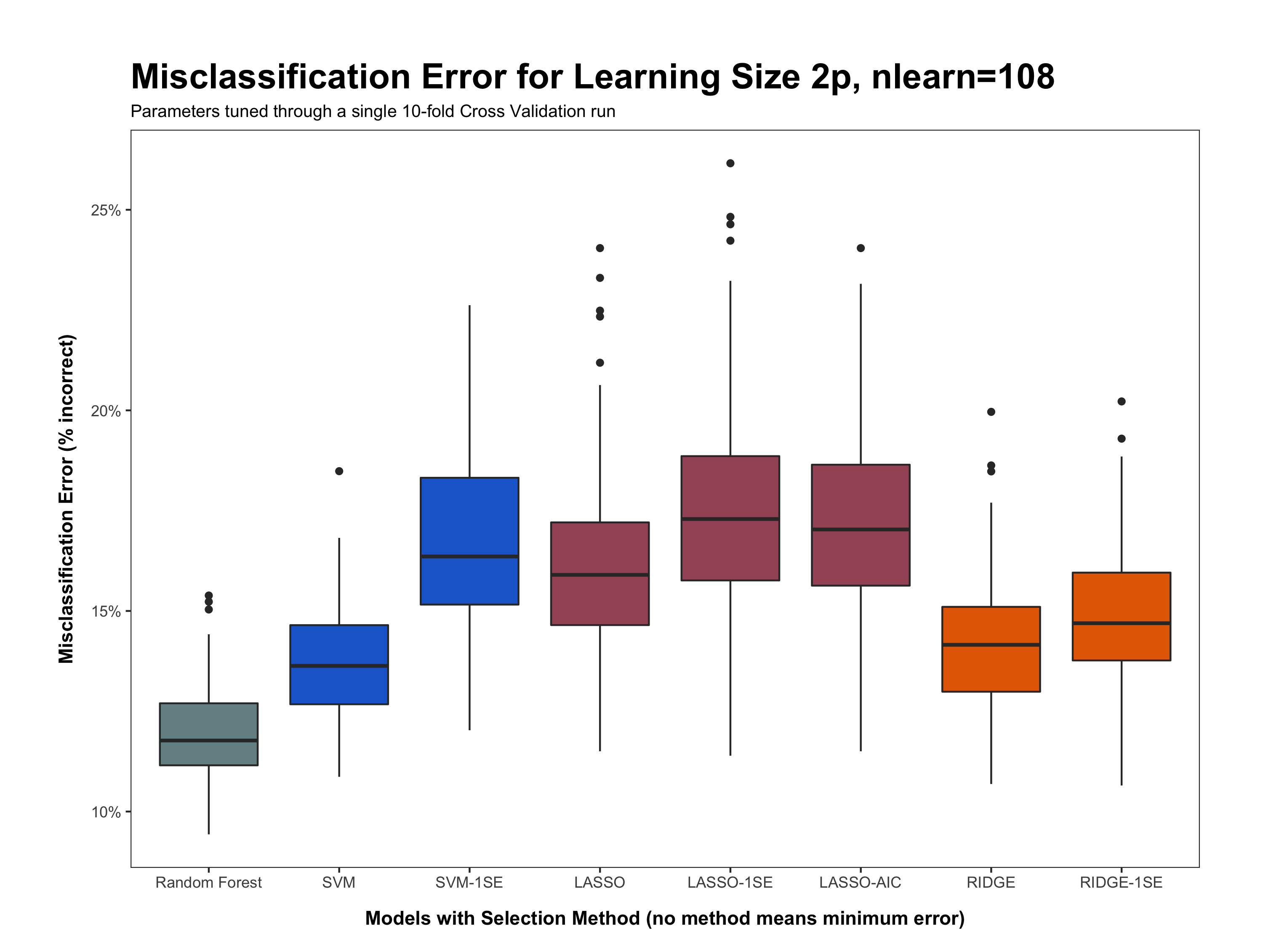
ntree | 500
mtry | 7
replace | TRUE
cost | 10
gamma | 0.006
cost | 100
gamma | 0.010
lambda
0.07405
lambda
0.10744
lambda
0.00003
lambda
0.19566
lambda
0.95139

Slide 4
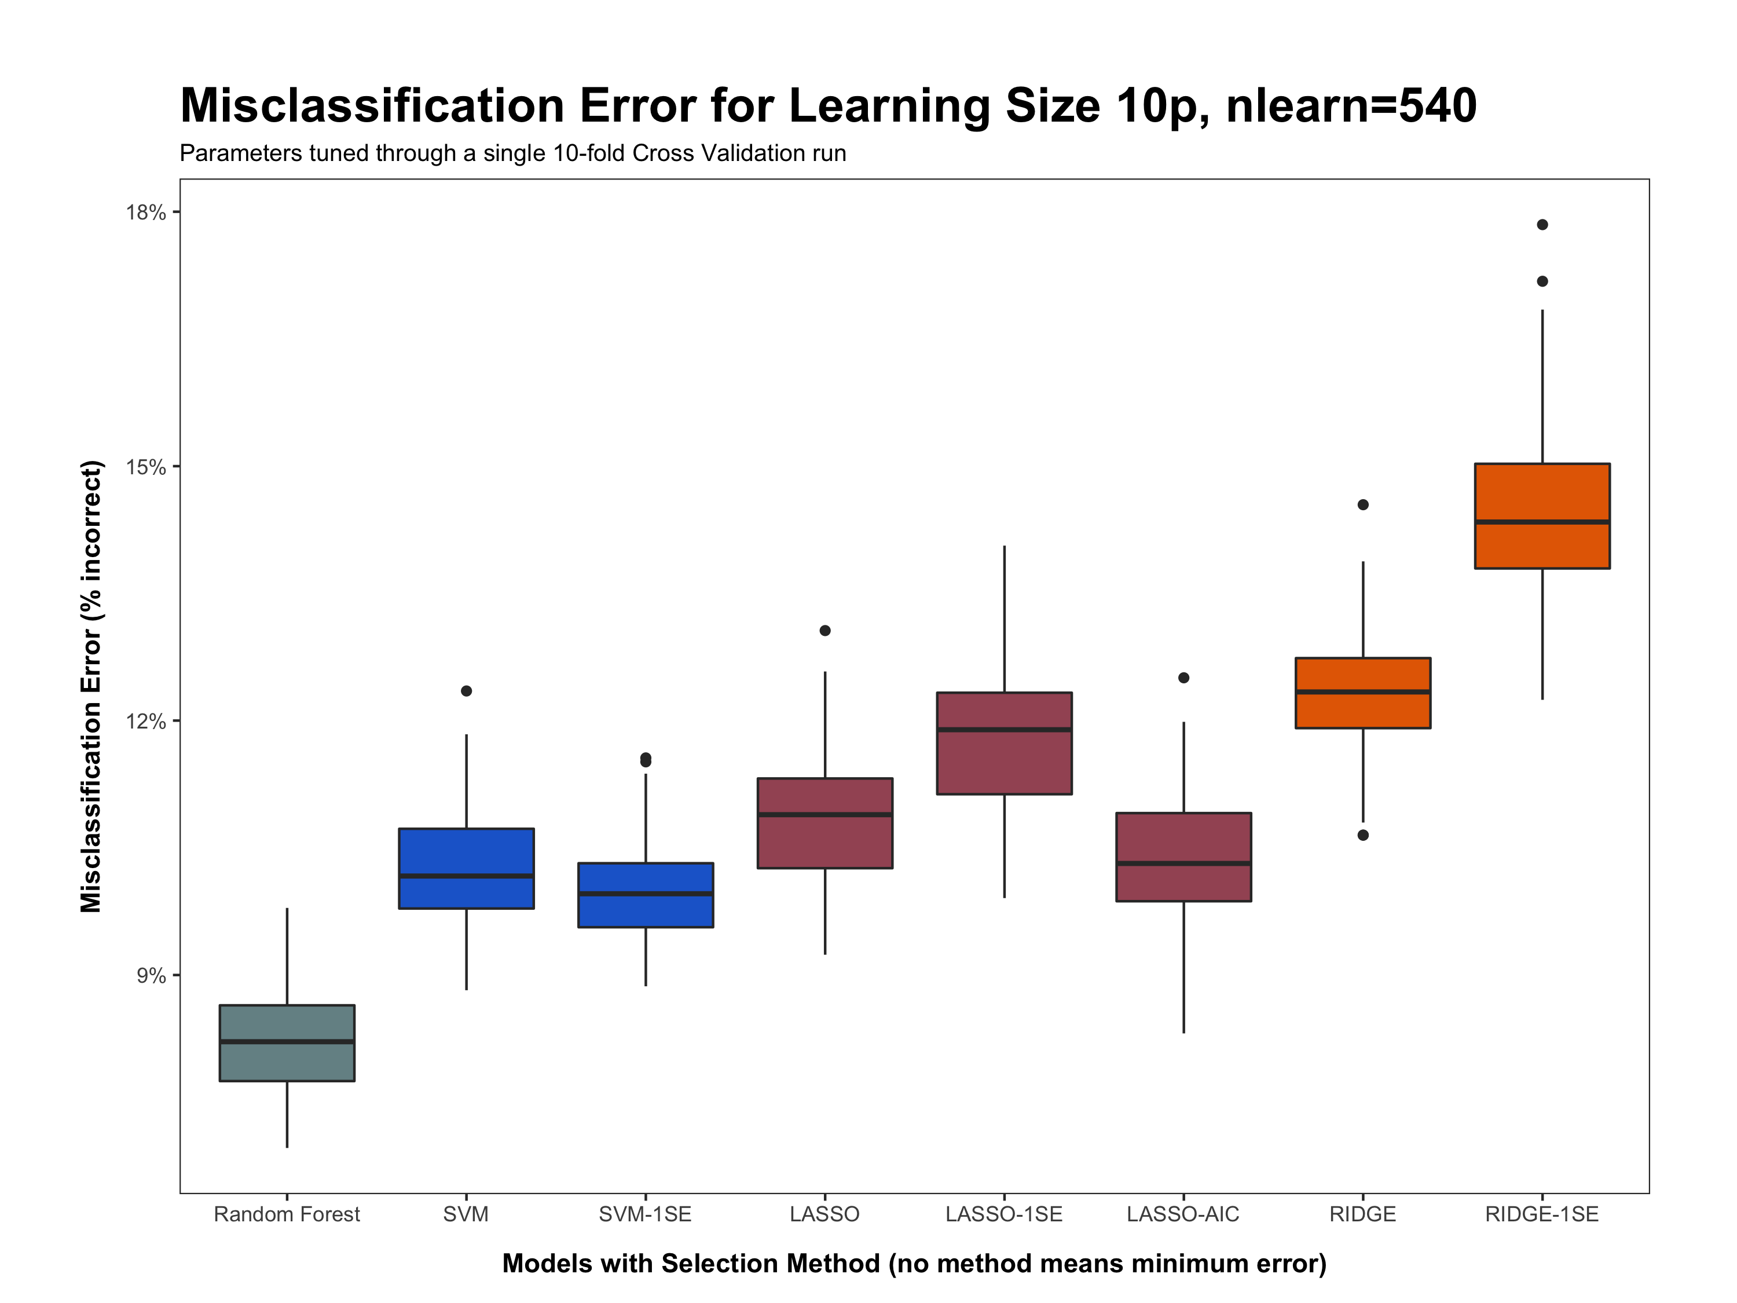
ntree | 1000
mtry | 8
replace | FALSE
cost | 200
gamma | 0.002
cost | 10
gamma | 0.007
lambda
0.00562
lambda
0.01563
lambda
0.00002
lambda
0.2450
lambda
1.08551

Slide 5
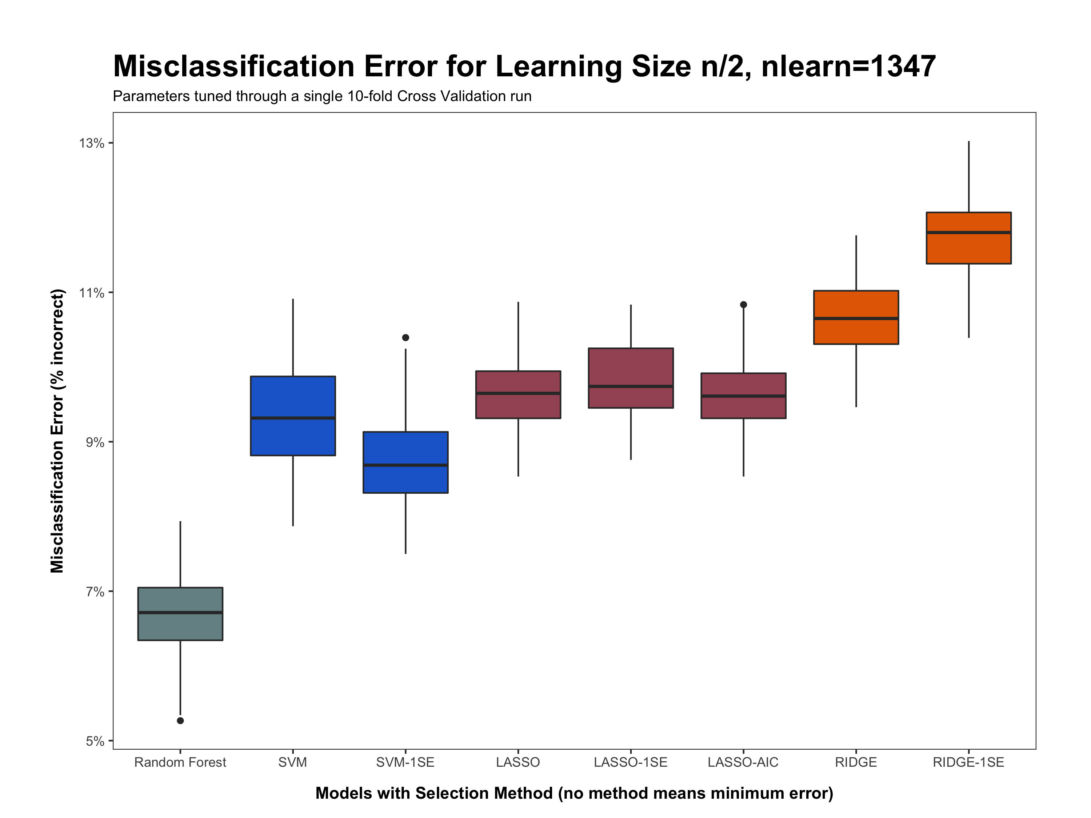
ntree | 500
mtry | 9
replace | FALSE
cost | 100
gamma | 0.008
cost | 10
gamma | 0.008
lambda
0.00008
lambda
0.00136
lambda
0.00004
lambda
0.02237
lambda
0.15784

Slide 6
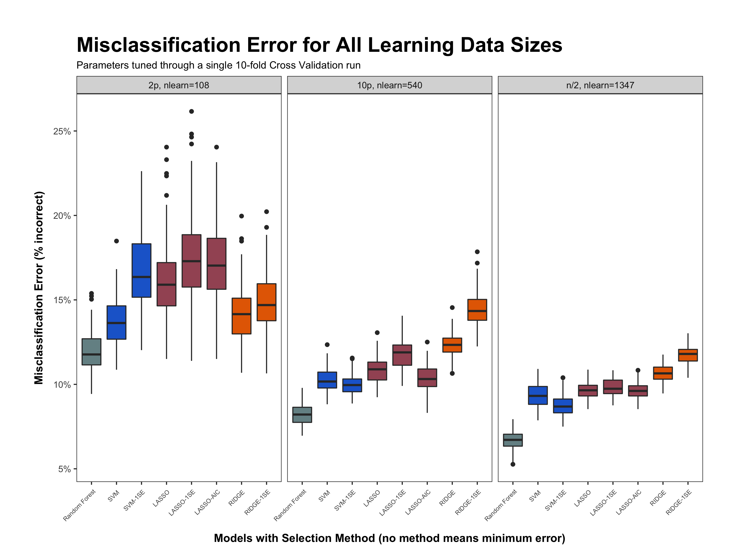

Slide 7
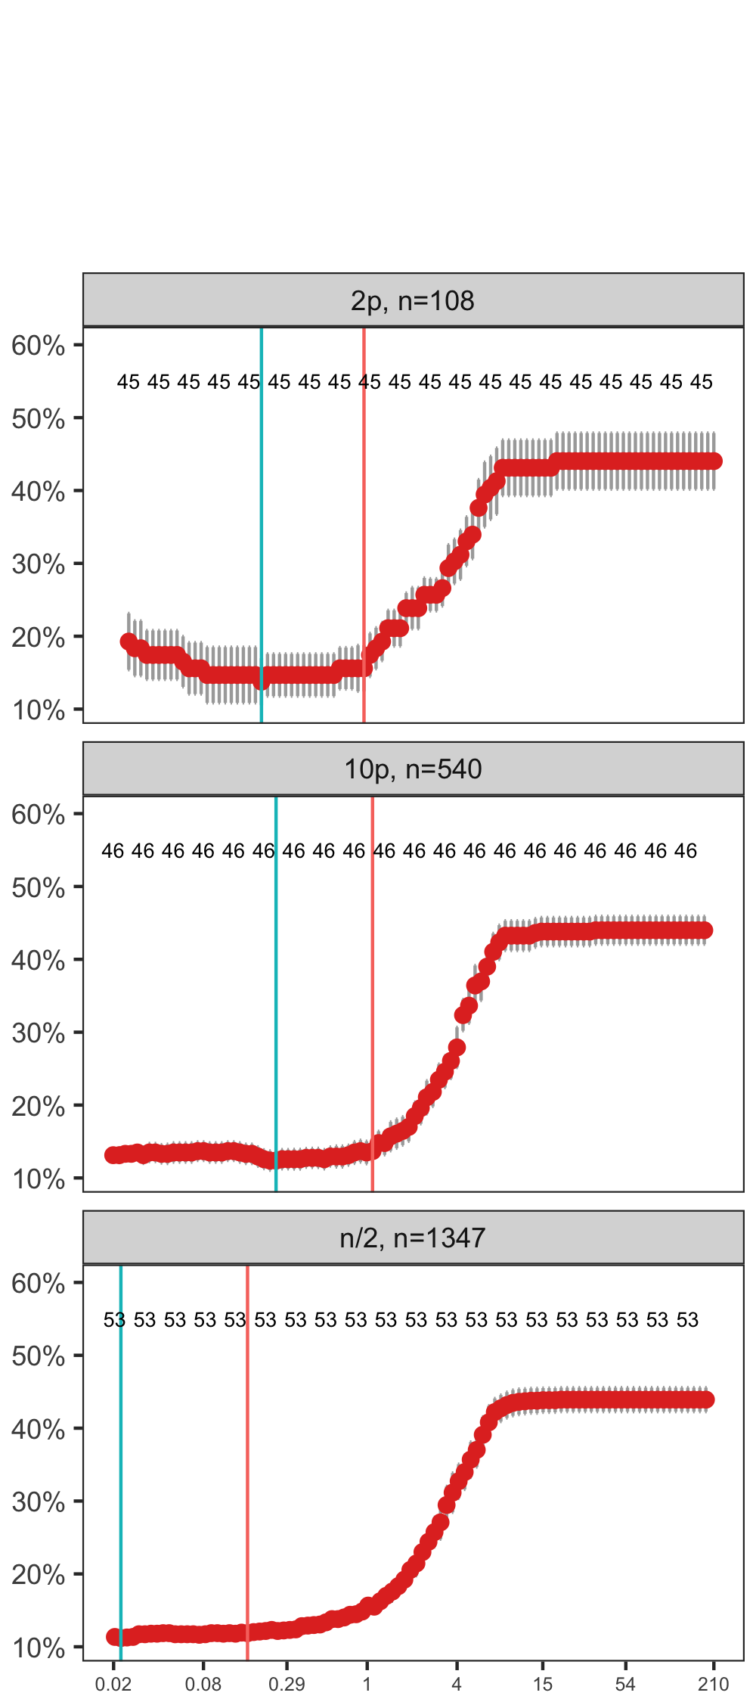
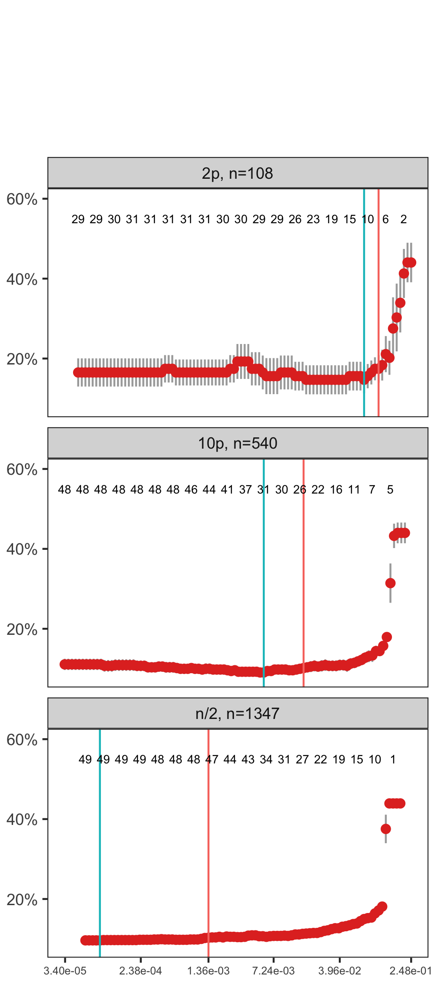
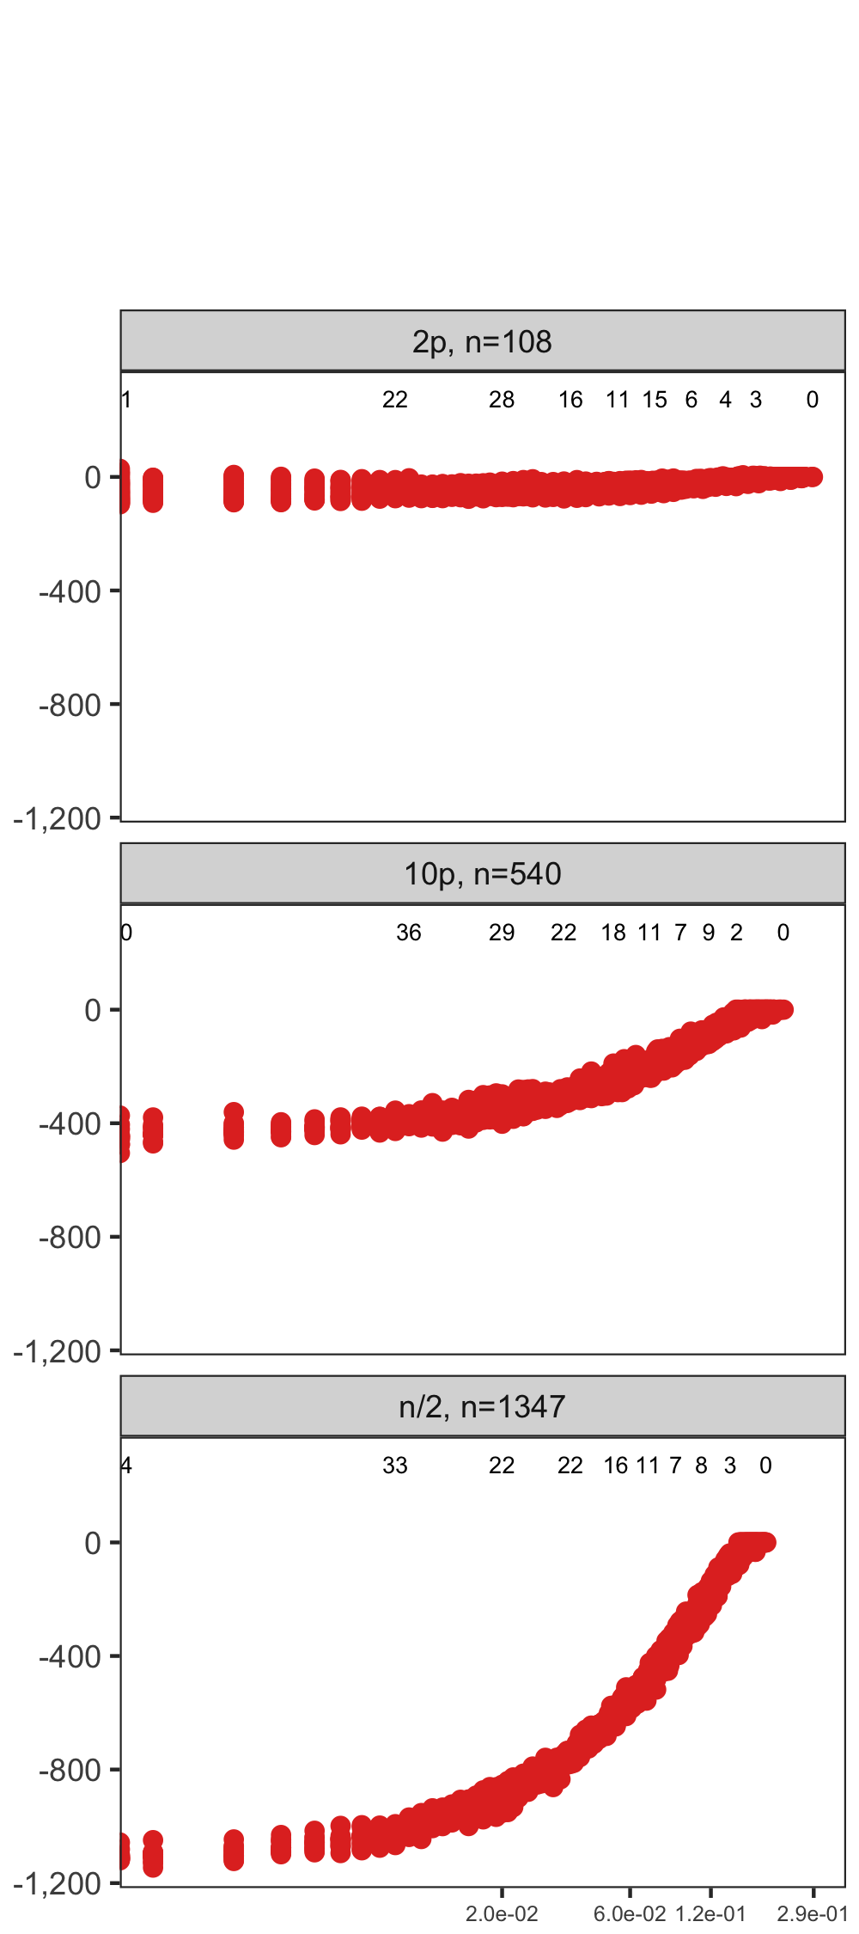
Cross Validation Curve
Lasso AICC Curve
Ridge
Minimum Error
1 Standard Error
Lasso
Lasso
X-axis is Misclassification Error
Y-axis is Lambda Values
X-axis is AICC
Y-axis is Lambda Values
0.195655
0.074051
0.951394
0.107436
0.245002
0.005617
1.085509
0.015629
0.022373
0.000083
0.157830
0.001356

Slide 8
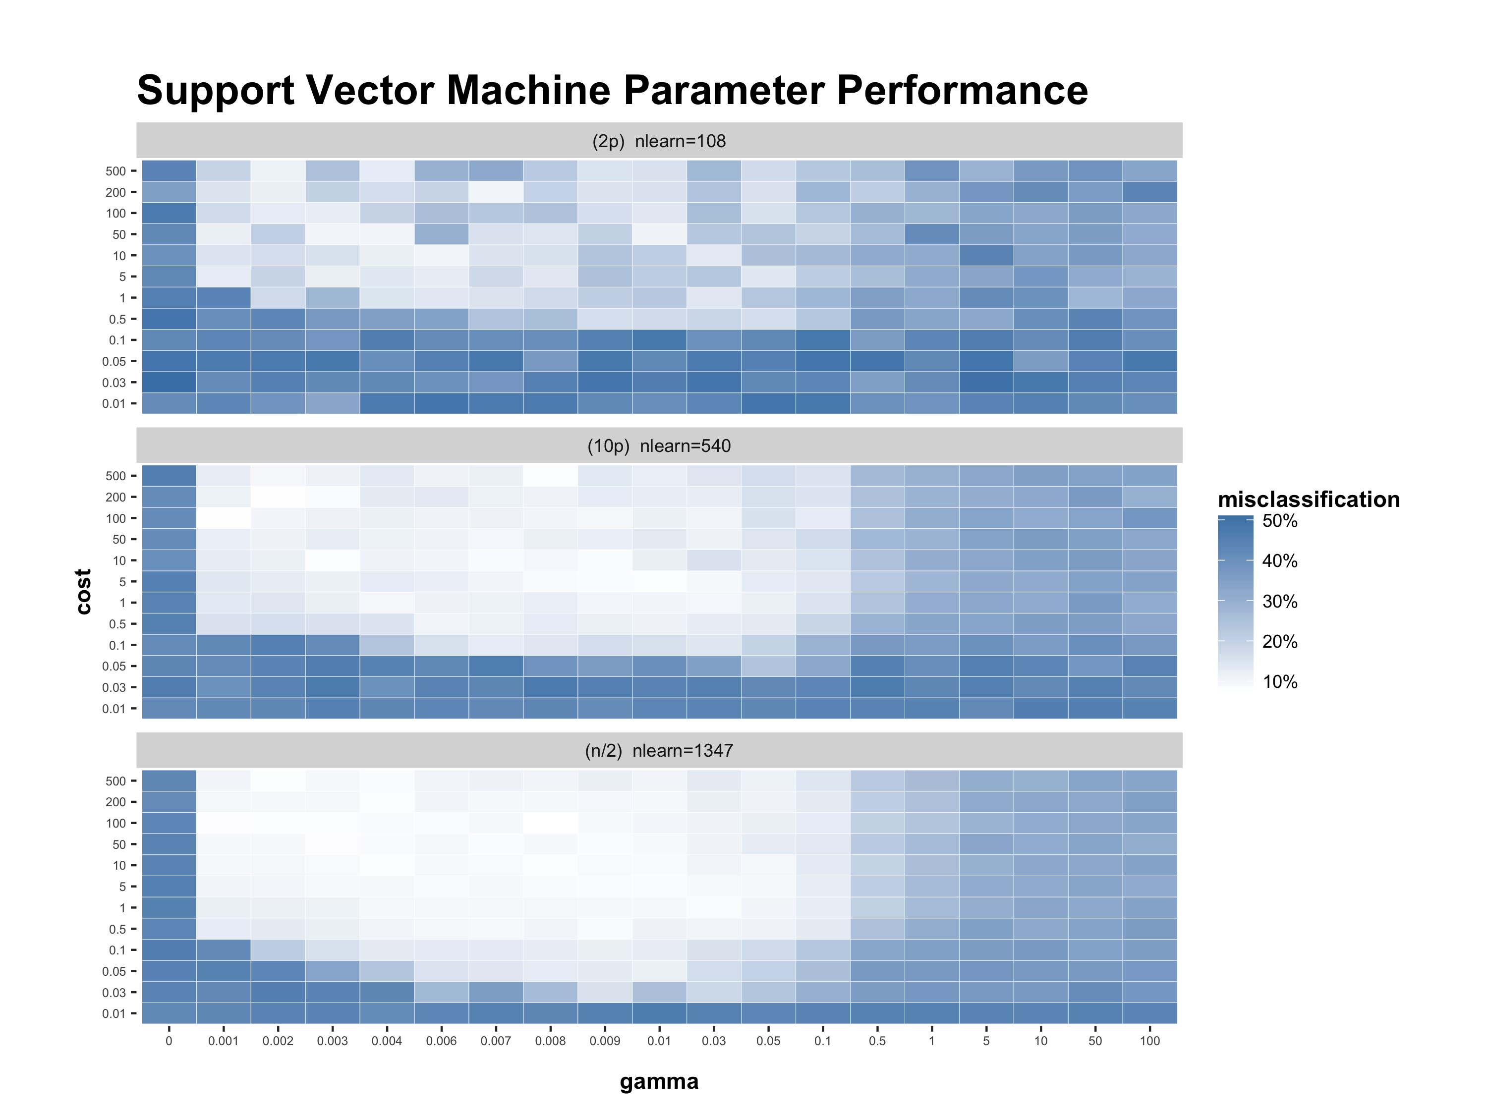

Slide 9
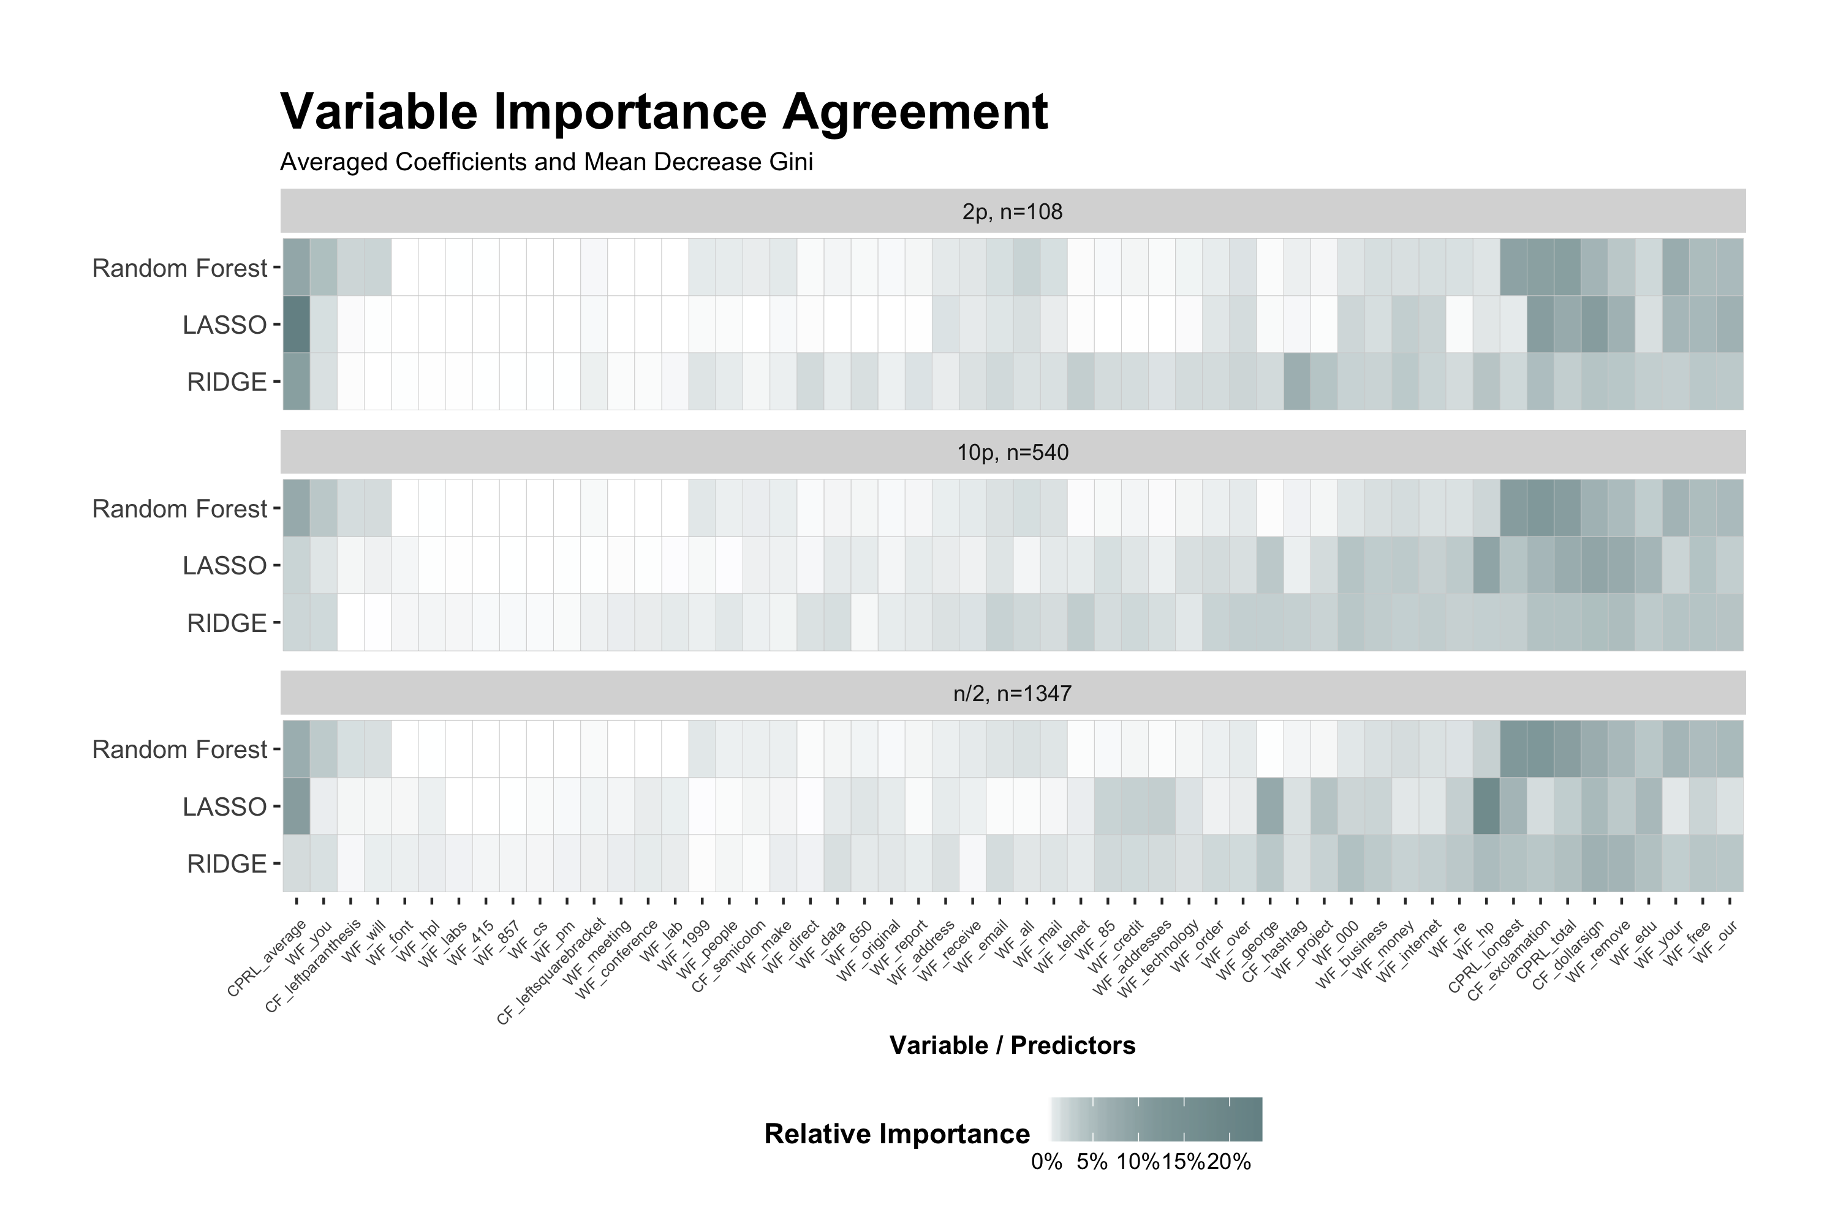
Model
Variable Naming Scheme
<variable type>_<word/character/measure>
WF – Word Frequency (% of total words in an email)
CF – Character Frequency (% of total characters in an email)
CPRL – Capital Run Length (The length of a sequence of capital letters)

